Slide 1
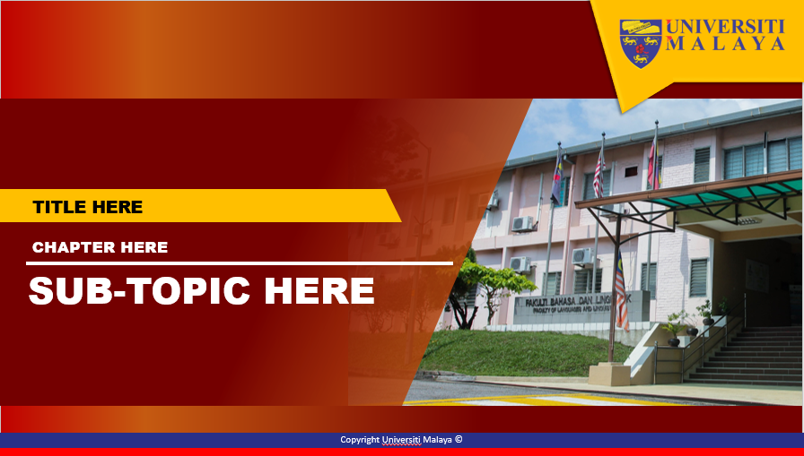
FAKULTI BAHASA DAN LINGUISTIK
GBT 0002 : CRITICAL THINKING AND PROBLEM SOLVING SKILLS
PN SITI ROHANA BINTI MOHD THANI
srohana@um.edu.my
603-7967 3116

Slide 2
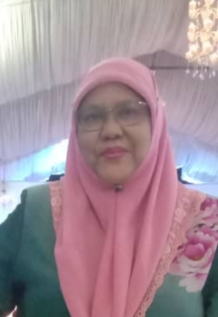
WEEK 9
JUDGING CREDIBILITY OF SOURCE

Slide 3
Judging Credibility and Source
Week 9
Critical Thinking and Problem Solving Skills
By
Siti Rohana Binti Mohd Thani

Slide 4
Introduction
Since many of our beliefs are based on what other people tell us (in writing or by word of mouth), the critical thinker needs to know how to decide who to believe.
Most of what we learn is learnt from others—from teachers, parents, experts, friends, television, newspapers, magazines, the internet, journals, textbooks, etc. The question is, “Which of these can we believe?”

Slide 5
Introduction
We may accept or reject a claim because of the source from which we learn it.
We make judgements about credibility in order to help us decide what is true.

Slide 6
Considerations
Source’s reputation
Vested Interest
Corroboration
Expertise / Training
Nature of the claim
Credible reasons

Slide 7
5 Sections
Person / Source
Circumstances /
Context
Justification
Nature of the claim
Corroboration

Slide 8
5 Sections (example)
Person / Source
Circumstances /
Context
Justification
Nature of the claim
Corroboration
A British policeman (the source) might testify in court (the context) that he saw (the justification) the defendant pass a sword through a woman on stage (nature of the claim), and others might testify that they saw it too (corroboration)

Slide 9
5 Sections (example)
A newspaper reporter employed on the US National Enquirer (the source) might report in the newspaper (the context) that he had been informed (the justification) that the Titanic had resurfaced (nature of claim), and that the US Navy had eye-witness reports about this remarkable event (corroboration).
Person / Source
Circumstances /
Context
Justification
Nature of the claim
Corroboration

Slide 10
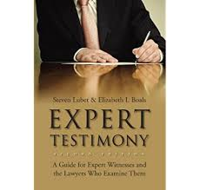
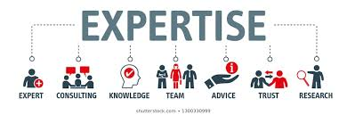
1. Person / Source
Relevant expertise?
Experience
Knowledge
Formal Qualifications

Slide 11
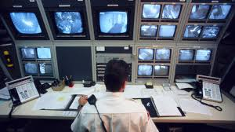
1. Person / Source
Ability to observe accurately?
Eyesight
Hearing
Proximity to event
Absence of distractions
Appropriate instruments
etc

Slide 12
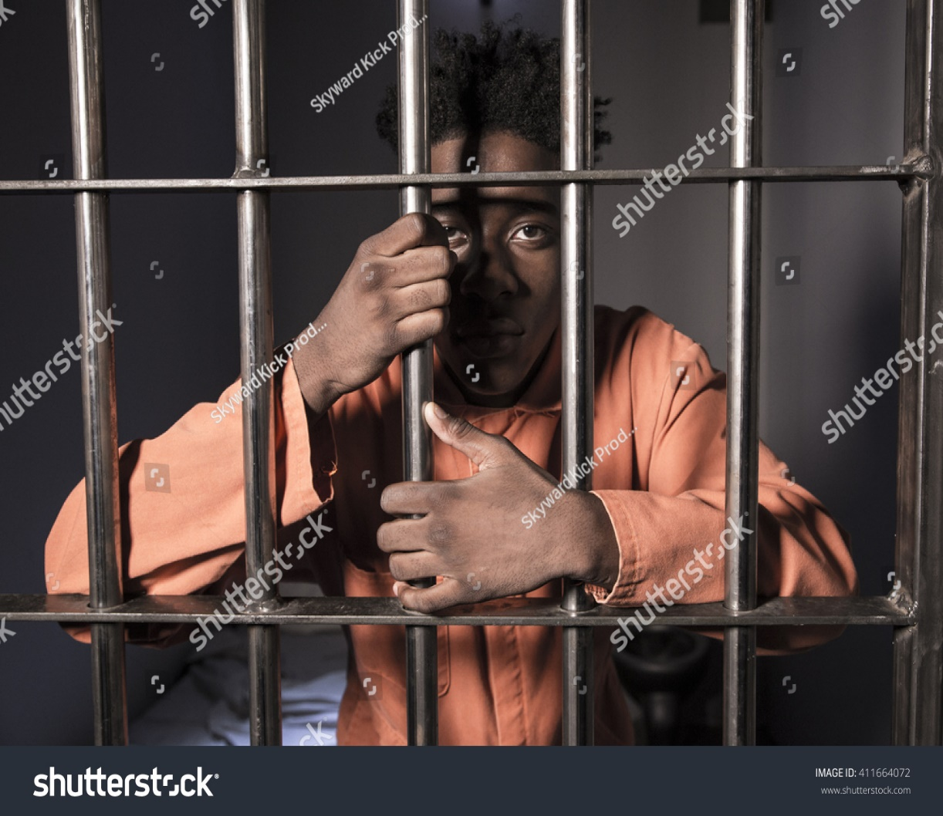
1.Person / Source
Reputation reliable?
Honest
Telling the truth
Being correct

Slide 13
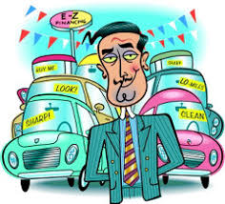
1.Person / Source
Vested interest or bias?
Financial interest
Something to lose / gain from not telling the truth

Slide 14
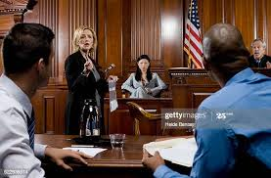
2. Circumstances /Context
In which the claim is made?
Court vs bar
Tabloid vs broadsheet
Journal vs magazine

Slide 15
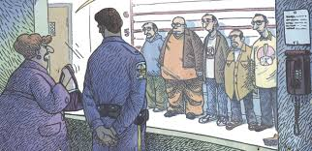
3. Justification
“I witnessed X’ vs
“She told me”

Slide 16
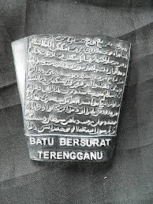
3. Justification
‘Primary’ vs ‘secondary’ sources?

Slide 17
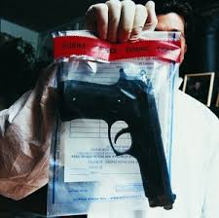
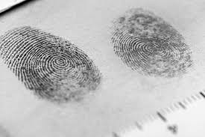
3. Justification
‘Direct’ justification / evidence
vs
circumstancial’ evidence

Slide 18
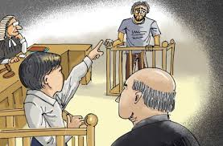
3. Justification
Direct reference to credibility considerations

Slide 19
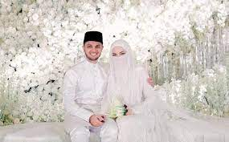
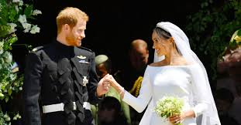
4. Nature of claim
Is it very unlikely?
Is it plausible?
Easy to believe?

Slide 20
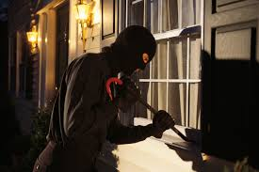
4. Nature of claim
Basic observation statement or an inferred judgement?

Slide 21
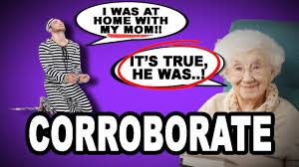
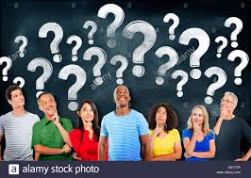
5. Corroboration
From other sources?

Slide 22
Exercise 1
You are considering buying a second-hand car, but, since you know very little about cars, you have employed an expert mechanic from XXX (who is not acquainted with the present owners) to check the vehicle over; he tells you that the car is in good condition and that it would be a good buy. Should you believe him? Why or why not?
How credible is the mechanic we have asked to advice us? Give reasons.

Slide 23
Exercise 1 (Answer)
We can be confident in accepting his advice because:
He has the relevant expertise
He has no bias or vested interest
The organization he works for has a good reputation and is reliable.
(Fisher, 2001)

Slide 24
Evaluating Credibility---Example:
Evidence Claim Conclusion
Dr Jones says What Dr Jones Cyclomates consumed
‘Cyclomates says is true by humans will cause
consumed → → cancer
by human will
cause cancer.’
Credibility Questions:
Dr Jones is an 1. Is Dr Jones objective?
expert on cancer 2.How good are Dr Jones’ credentials?
research 3. What are the reasons for Dr Jones’
conclusions? (Did she conduct the
study? What are the results?

Slide 25
Exercise 2
The doctor hired by the tabacco company who says there is no proof that smoking is addictive or causes lung cancer.
The new Health Director-General who says that marijuana should be made legal.
A Consumer Report that states that Perodua is the best-selling car in Malaysia.
An advertisement that states that Perodua is the best-selling car in Malaysia.
George W. Bush, ex-President of the USA, who said that Iraq was in possession of weapons of mass destruction.
Dr Noor Hisham,the Health Director-General of Malaysia who says that Covid-19 cases can be reduced if people stay put at home, wear mask when going out, wash hand regularly, and have social distancing.
Evaluate the credibility of the following sources:

Slide 26
Doing your Research
Directional Information
Information Materials
Indexes
Bibliographies
Card catalogues
Guides to reference sources
Online databases
Encyclopedias
Newspapers
Journals
Magazines
Dictionaries
Books
Gov docs
Websites

Slide 27
Evaluating Sources
Content: Facts & Everything else
The author and the publisher
The audience

Slide 28
Using Sources
Acknowledging sources
Incorporating sources

Slide 29
Any Questions
Thank you

